Slide 1
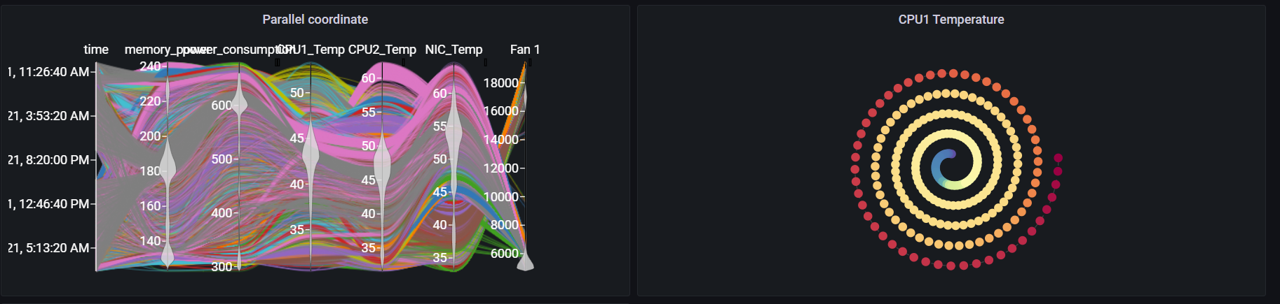
Grafana Plugin
Weekly report

Slide 2
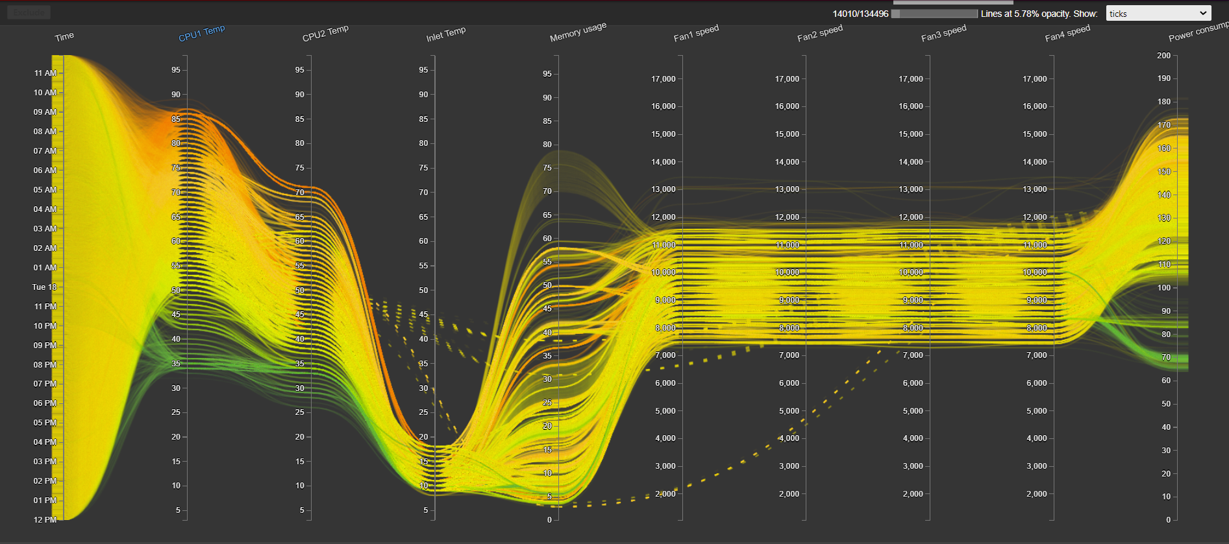
Original visualization
https://idatavisualizationlab.github.io/HPCC/ParallelCoordinates/index.html

Slide 3
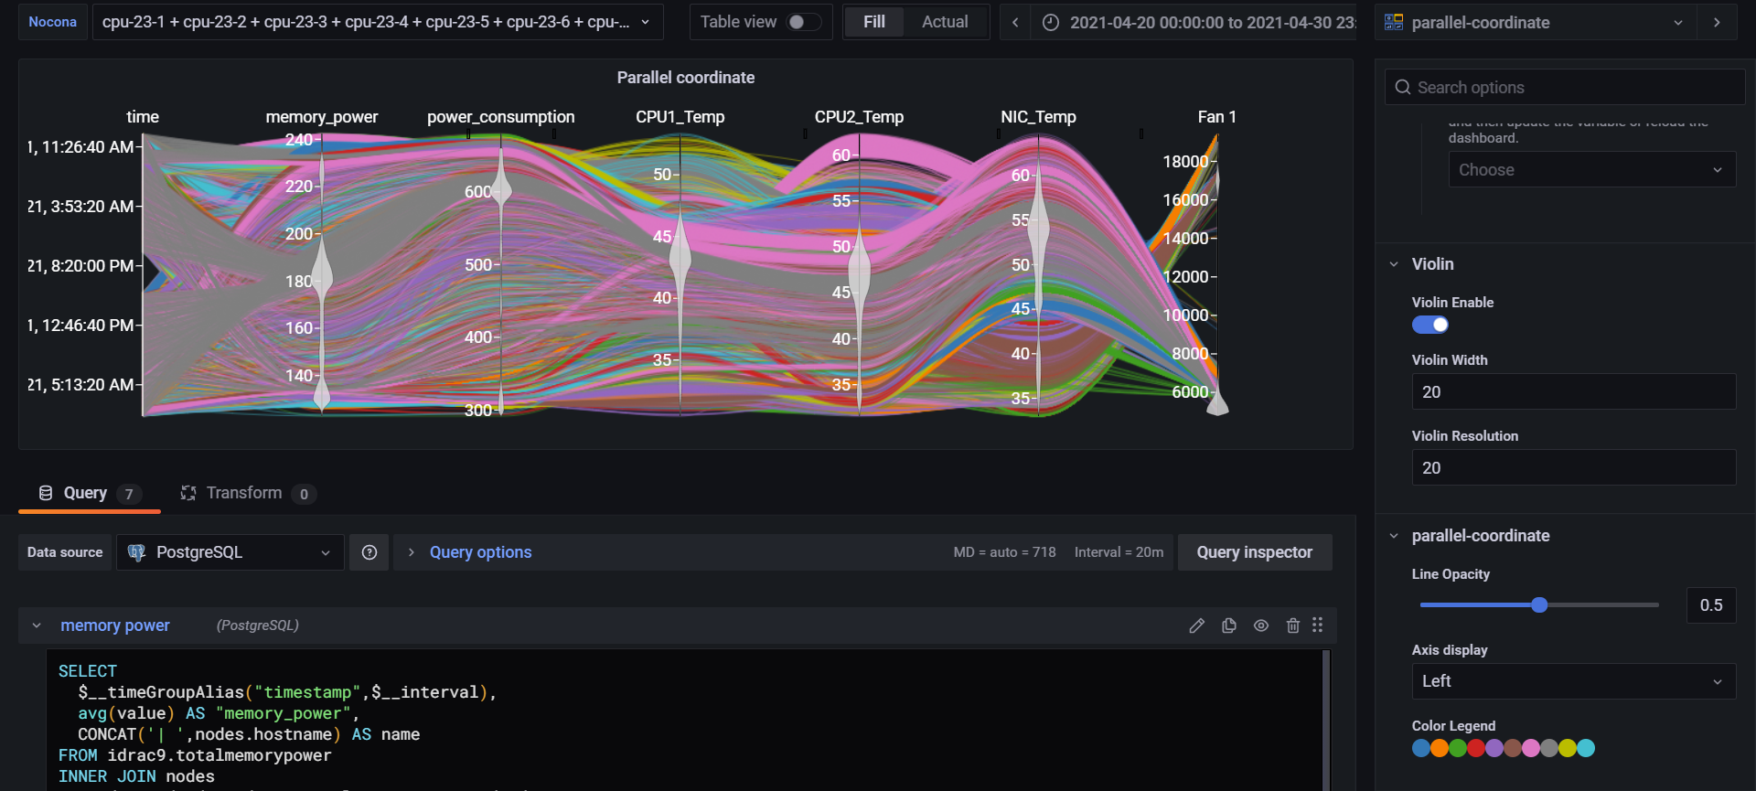
Previous result
Primary app: https://idatavisualizationlab.github.io/HPCC/ParallelCoordinates/index.html

Slide 4
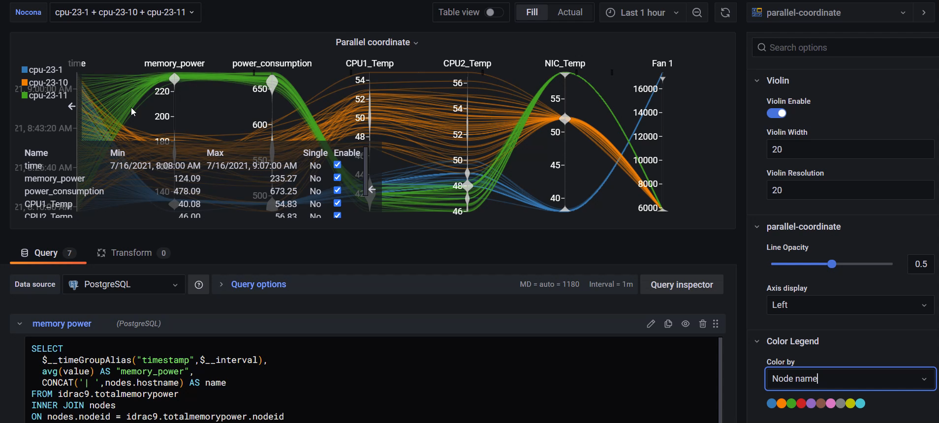
Current result
Primary app: https://idatavisualizationlab.github.io/HPCC/ParallelCoordinates/index.html

Slide 5
Current features
Violin summary on each axis
Show node information when filter
Reformat color legend
Color by Metrics (current color by compute)
Dimension statistic (avoid showing single/ double unique values)

Slide 6
Future features
Rendering by sequences

Slide 7
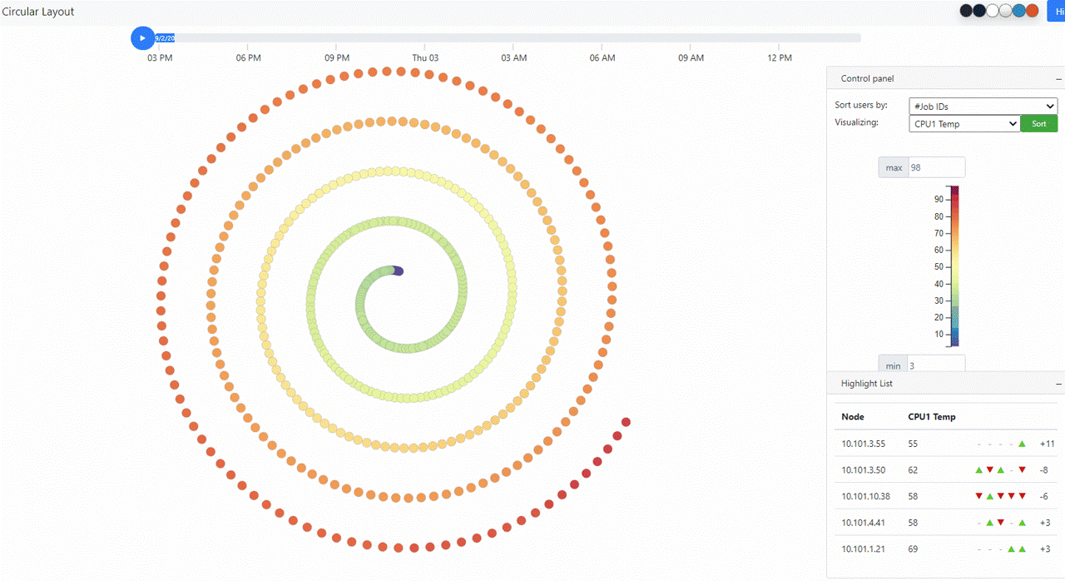
Original visualization
https://idatavisualizationlab.github.io/HPCC/spiralLayout/index.html

Slide 8
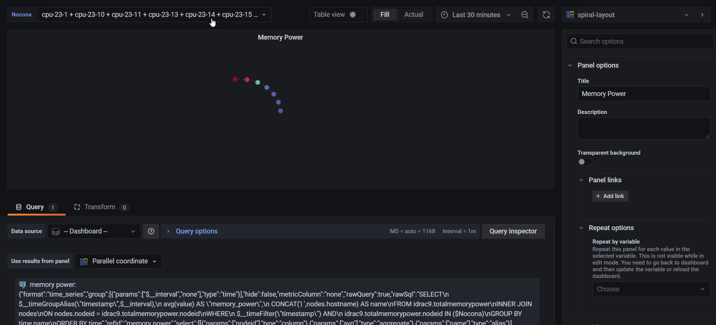
Previous features

Slide 9
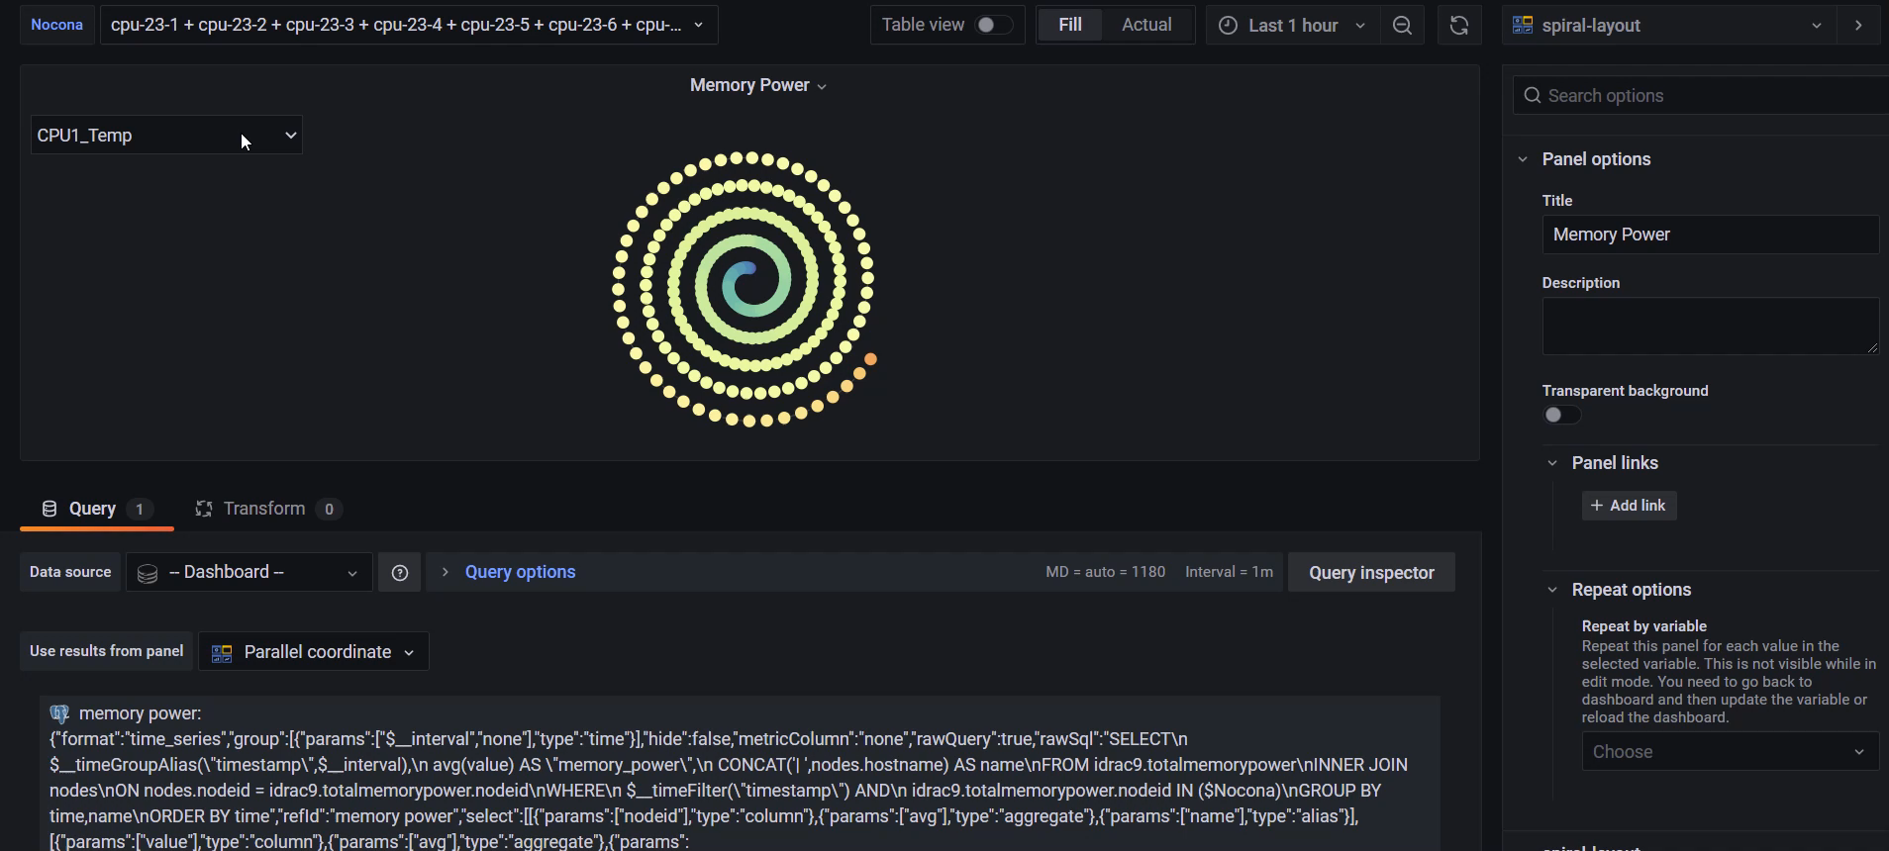
Current features

Slide 10
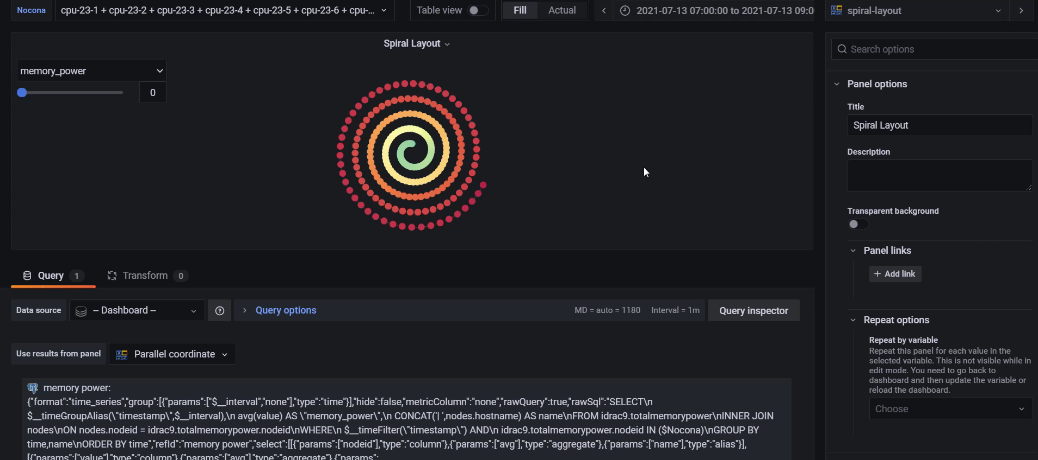
Current features

Slide 11
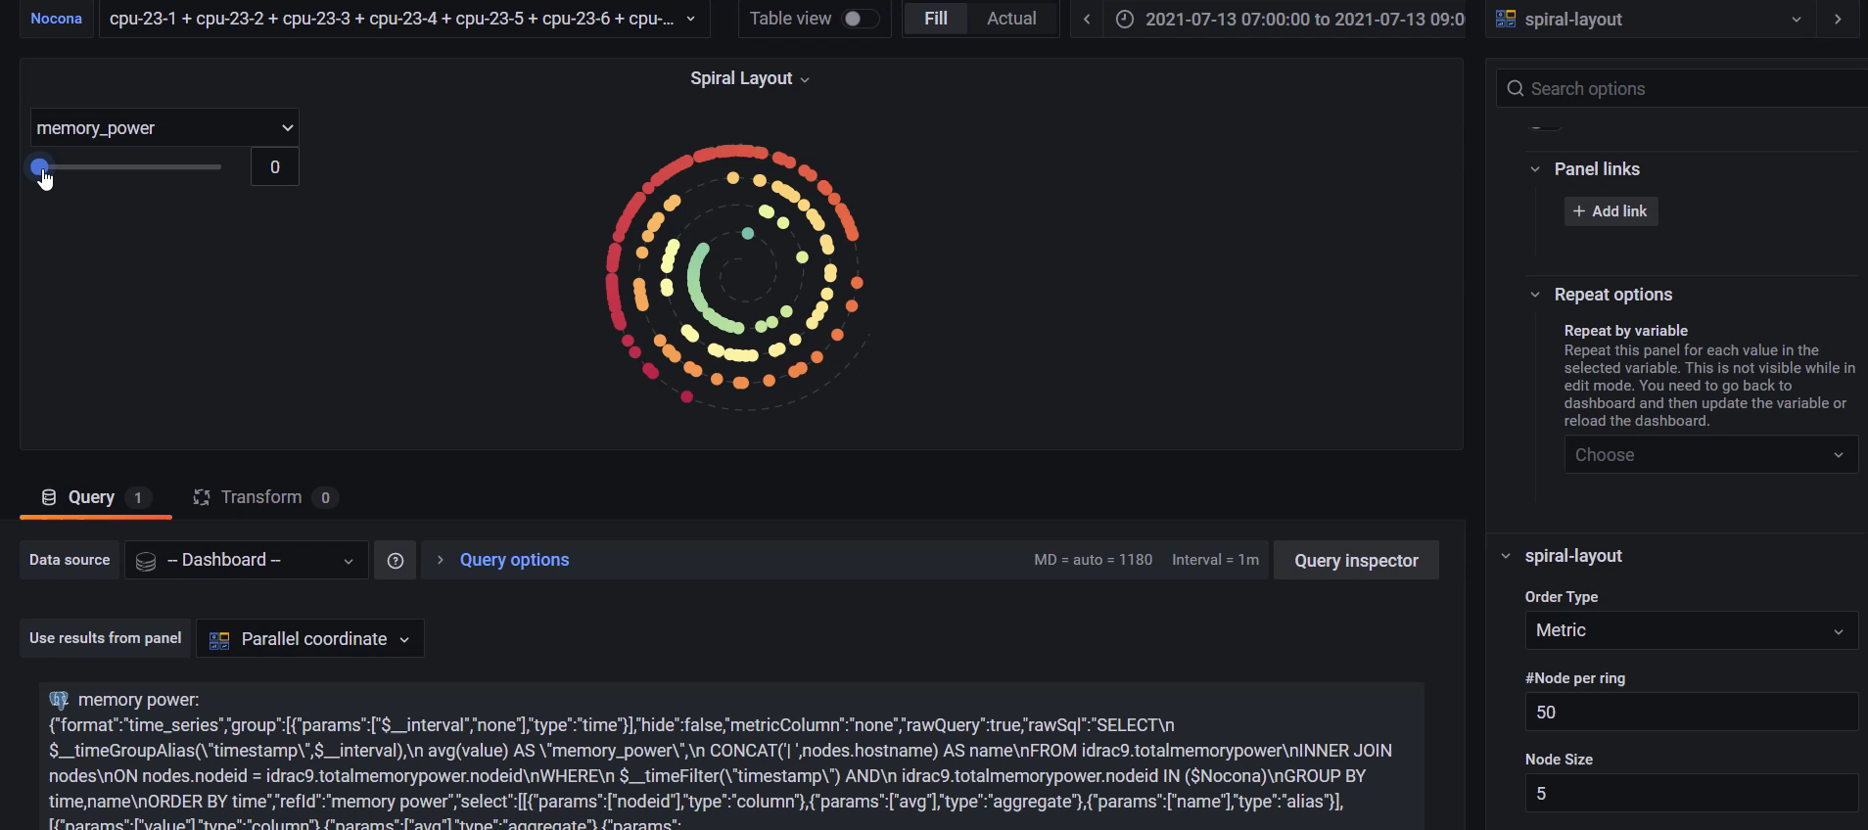
Current features

Slide 12
Current features
Linear scale and None linear scale for spiral layout
Selectable metric
Quick tooltip
Selectable time range
Trajectory (heatmap)
Hold selection by click

Slide 13
Future features
Adjust time range in Time format
Fixed metrics dimension

Slide 14
Job related data
Able to query job data with the query by time and running node:
SELECT *FROM slurm.jobsWHERE start_time < ${__to:date:seconds} AND end_time BETWEEN ${__from:date:seconds} and ${__to:date:seconds} AND ARRAY[${Nocona:csv}] && nodes
This query no longer working since the node is not the node id but node name

Slide 15
PowerMap
Transfered 80% code:
100% visualization code
60% data processing code

